Slide 1
Class Diagram
Modelling with Classes

Slide 2
What is UML?
The Unified Modelling Language (UML) is a standard graphical language for modelling object oriented software
At the end of the 1980s and the beginning of 1990s, the first object-oriented development processes appeared.

Slide 3
Unified Modeling Language
  In 1997 the Object Management Group (OMG) started the process of UML standardization (version 1.0)
  In 2004, the OMG approved version 2.0 of UML

Slide 4
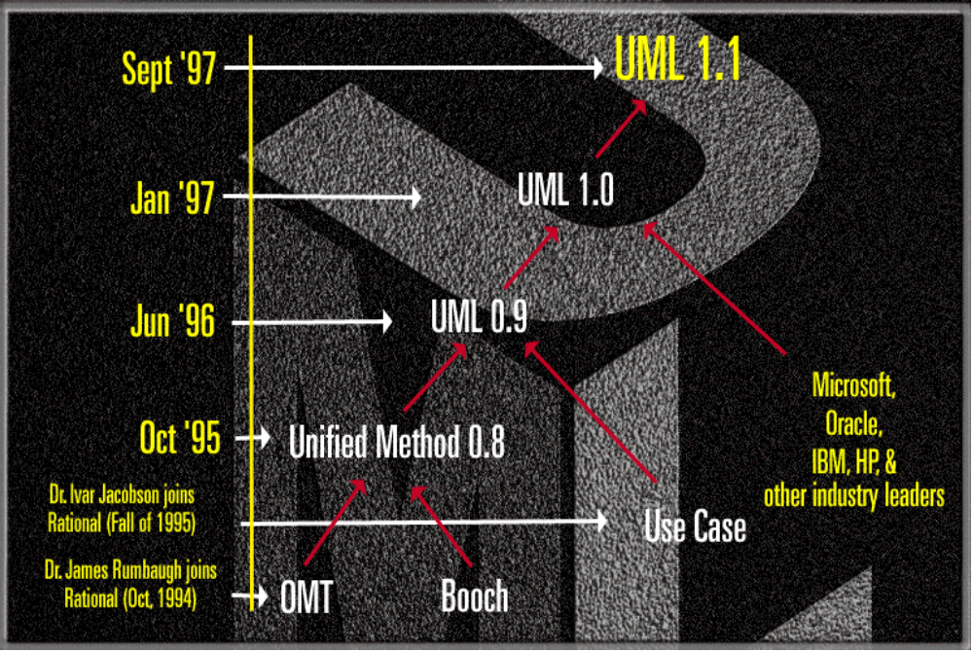
The Evolution of UML
Nov ‘97
UML approved by the OMG

Slide 5
Why would you use UML
To learn OO
  CRC cards Class-Responsibility-Collaboration
  Class diagrams
  Interaction diagrams
  Design patterns
Communicate with domain experts
  Use cases
  Class diagrams (conceptual)
  Activity diagrams

Slide 6
UML Diagrams
Use-Case diagram
Class diagram
Object diagram
State diagram
Sequence diagram
Collaboration diagram
Activity diagram
Component diagram
Deployment diagram

Slide 7
UML Diagrams
Class diagrams
  describe classes and their relationships
Object diagrams
  show the behaviour of systems in terms of how objects interact with each other

Slide 8
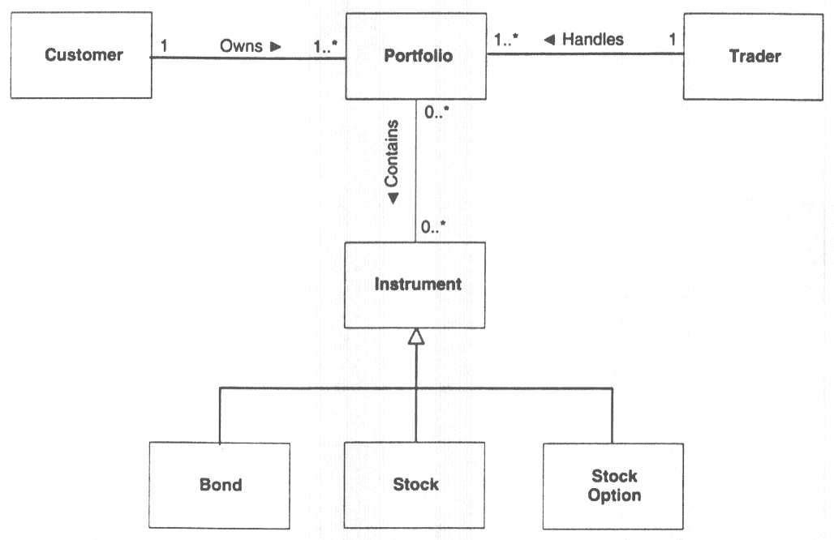
Class Diagram

Slide 9
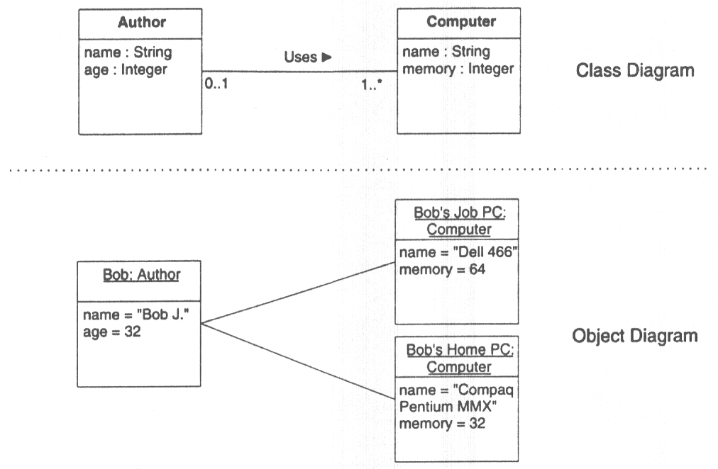
Object Diagram

Slide 10
Logical View
Shows how the functionality of the system is designed / provided
Uses class and object diagrams to represent the static structure
Uses state, sequence, collaboration, and activity diagrams for dynamic behaviour
Used by designers and developers

Slide 11
Class Diagrams

Slide 12
UML Class Diagrams
A view of the system in terms of classes and relationships
Behaviour as well as information in the system is modeled

Slide 13
Essentials of UML Class Diagrams
The main symbols shown on class diagrams are:
  Classes
      represent the types of data themselves
  Associations
      represent linkages between instances of classes
  Attributes
      are simple data found in classes and their instances
  Operations
      represent the functions performed by the classes and their instances
  Generalizations
      group classes into inheritance hierarchies

Slide 14
Examples of Classes
In business and information systems :
  Customer
  Agreement
  Invoice
  Debt
  Asset
  Quotation

Slide 15
Examples of Classes
In technical systems
  Sensor
  Display
  I/O card
  Engine
  Button
  Control class

Slide 16
Examples of Classes.
In system software :
  File
  Executable program
  Device
  Icon
  Window
  Scrollbar
Actually everything that has certain properties and behaviour

Slide 17
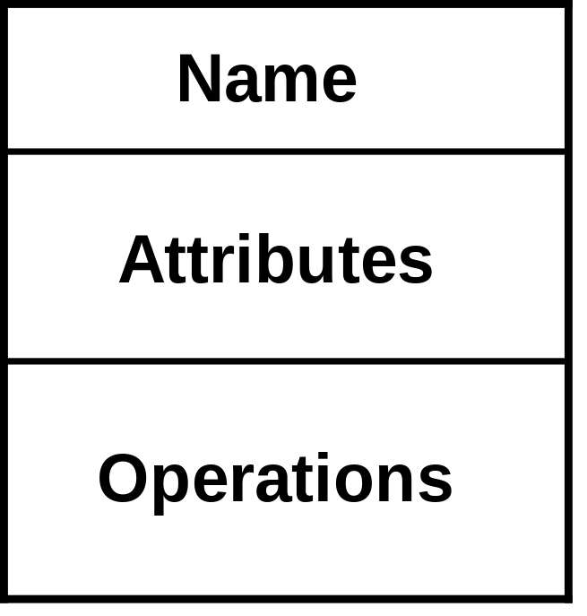
A Class in UML
A class is simply represented as a box with the name of the class inside
The diagram may also show the attributes and operations
The name compartment
  Starts with an uppercase ,
  Boldface
  Most of the time a noun

Slide 18
A Class in UML
The attributes compartment
  Starts with a lowercase
  Has a type e.g. String, Integer, …
  Has a visibility (language depended)
    public (+), private (-), protected (#)
  Default values can be specified
  Allowed values can be specified ({...})
  Class scope is possible (underlined)

Slide 19
A Class in UML
The operation compartment
  Contains the signature of the operation
    a return type
    a name
    zero or more parameters
  Has a visibility
    public (+), private (-), protected (#)

Slide 20
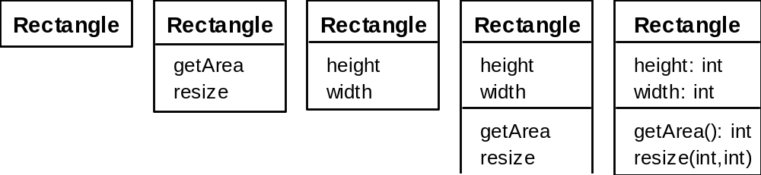
A Class in UML
The complete signature of an operation is:
    operationName(parameterName: parameterType …): returnType

Slide 21
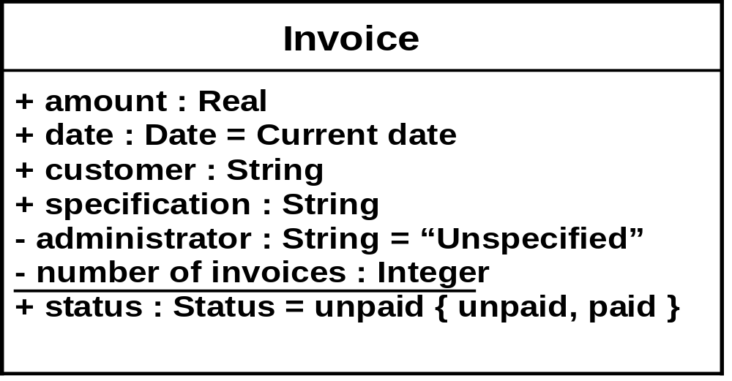
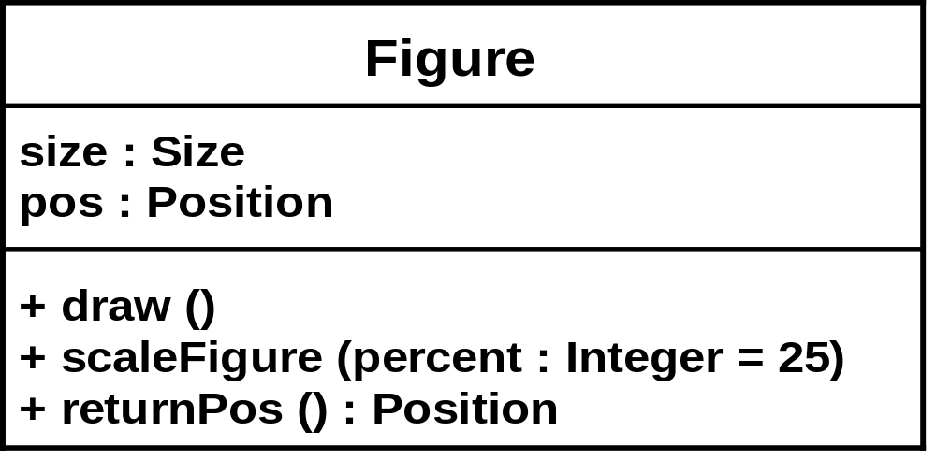
A Class in UML

Slide 22
Relationships Between Classes
An association is a connection between classes
A generalization is a relationship between a more general and a more specific element

Slide 23
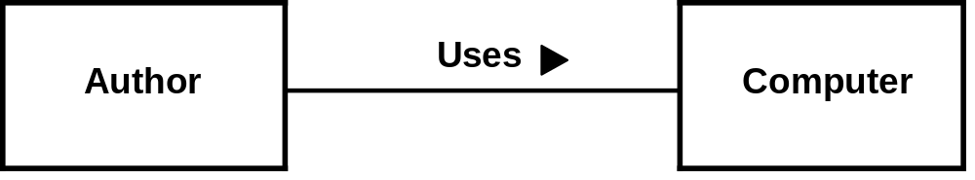
Associations and Multiplicity
An association is used to show how two classes are related to each other
Normally bi-directional
Could contain multiplicity
Association name
Association direction
Association

Slide 24
Associations and Multiplicity
Multiplicity
  A range that tells us how many objects are linked (indicates how many instances of the class at one end be linked to an instance of the class at the other end of the association)
  Symbols indicating multiplicity are shown at each end of the association:
    1 indicates that there must be exactly one instance linked to each object at the end of the association
    * indicates as “many”, means any integer greater than or equal to zero
    0..1 indicates multiplicity is to be “optional”
    Can be an interval or range, shown by two dots between lower and upper bound

Slide 25
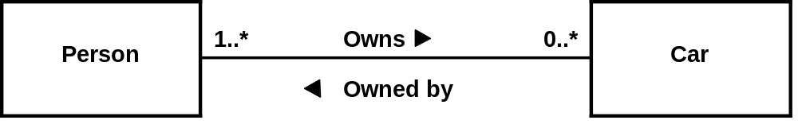
Associations and Multiplicity
Multiplicities
A Person Owns 0 or many Cars
A Car is Owned by 1 or many Persons

Slide 26
Associations and Multiplicity
Office
0..1
*
Employee
Person
0,3..8
*
BoardOfDirectors

Slide 27
Analyzing and validating associations
One-to-many
  A company has many employees, but an employee can only work for one company
Employee
*
1
Company

Slide 28
Analyzing and validating associations
Many-to-many
  A secretary can work for many managers
  A manager can have many secretaries
  Secretaries can work in pools
  Managers can have a group of secretaries
  Some managers might have zero secretaries.
  Is it possible for a secretary to have, perhaps temporarily, zero managers?

Slide 29
Analyzing and validating associations
One-to-one
  For each company, there is exactly one board of directors
  A board is the board of only one company
  A company must always have a board
  A board must always be of some company
1
1

Slide 30
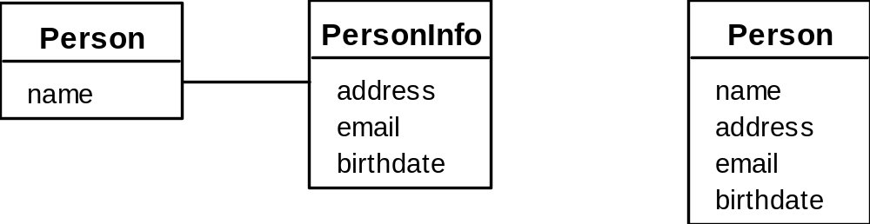
Analyzing and validating associations
One-to-one association are less common, the most common pattern is one-to-many.
Avoid unnecessary one-to-one associations
Avoid this do this

Slide 31
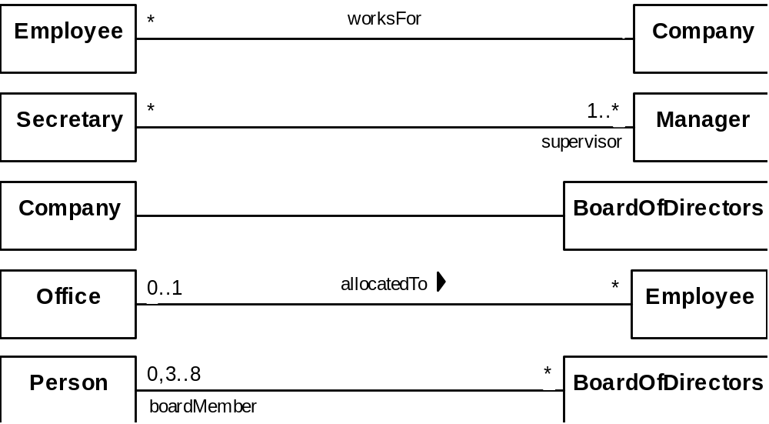
Labelling Associations
Each association can be labelled, to make explicit the nature of the association

Slide 32
Labelling Associations
Insurance
policy
0..1
expressed an
is expressed in an
Insurance
1
has
0..*
Insurance
company
refers to
contract
0..*
refers to
has
1..*
Customer

Slide 33
A more complex example
A booking is always for exactly one passenger
  no booking with zero passengers
  a booking could never involve more than one passenger.
A Passenger can have any number of Bookings
  a passenger could have no bookings at all
  a passenger could have more than one booking
*
*
*
*
*
*
*
*
*
*
*
Passenger
1
Booking
*
1
SpecificFlight

Slide 34
Association classes
Sometimes, an attribute that concerns two associated classes cannot be placed in either of the classes
  The solution is to create an association class.
  Represented by a dashed line
The following are equivalent:
*
*
*
*
*
*
Student
*
CourseSection
Registration
grade
Student
1
*
Registration
*
1
CourseSection
grade

Slide 35
Reflexive associations
It is possible for an association to connect a class to itself
successor
*
*
Course
isMutuallyExclusiveWith
*
*
prerequisite

Slide 36
Directionality in associations
Associations are by default bi-directional
It is possible to limit the direction of an association by adding an arrow at one end (unidirectional association)
*
Day
1
*
Note

Slide 37
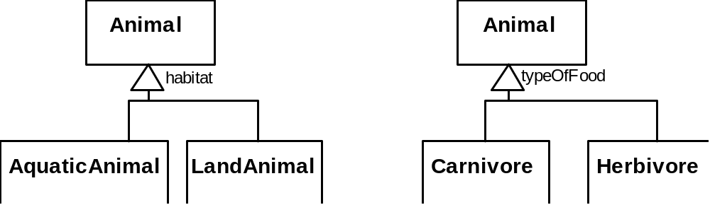
Generalization
Inheritance, ‘is-a’ relationship
Specializing a superclass into two or more subclasses.
  The generalization set is a label that describes the criteria used in the specialization

Slide 38
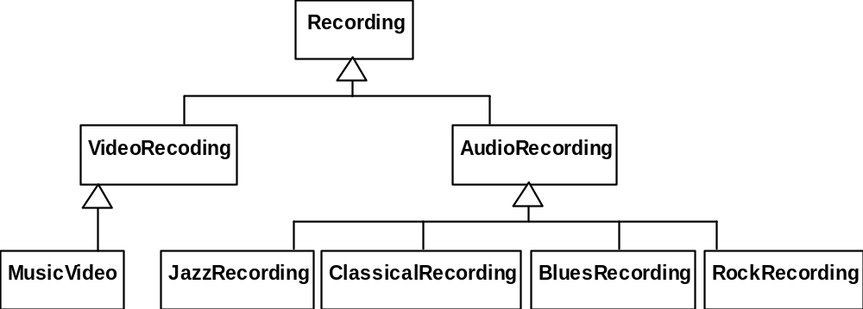
Avoiding unnecessary generalizations
Inappropriate hierarchy of
classes, which should be
instances
Improved class diagram,
with its corresponding
instance diagram
Recording
*
hasCategory
RecordingCategory
title
description
*
subcategory
artist
:RecordingCategory
:RecordingCategory
video
audio
subcategory
subcategory
subcategory
subcategory
subcategory
:RecordingCategory
:RecordingCategory
:RecordingCategory
:RecordingCategory
:RecordingCategory
music video
jazz
classical
blues
rock
:Recording
:Recording
9th Symphony
Let it be
Beethoven
The Beatles

Slide 39
Object Diagrams
Shows configuration of objects and links that may exist at a particular point during execution of a program.
A link is an instance of an association
  In the same way that we say an object is an instance of a class
Objects are shown as rectangles, just like classes; the difference is that the name of the class is underlined and preceded by a colon
  :Employee
Can also give a name to each instance before the colon
  Pat:Employee
Or, even omit the class name entirely
  Pat:

Slide 40
Object Diagrams
Pat:Employee
Wayne:Employee
OOCorp:Company
OOCorp's Board:
Ali:Employee
Carla:Employee
UML inc:Company
UML inc's Board
Terry:Employee

Slide 41
Associations versus generalizations in object diagrams
Associations describe the relationships that will exist between instances at run time.
  When you show an object diagram generated from a class diagram, there will be an instance of both classes joined by an association
Generalizations describe relationships between classes in class diagrams.
  They do not appear in object diagrams at all.
  An instance of any class should also be considered to be an instance of each of that class’s superclasses

Slide 42
More Advanced Features: Aggregation
Aggregations are special associations that represent ‘part-whole’ relationships.
  The ‘whole’ side is often called the assembly or the aggregate
  This symbol is a shorthand notation association named isPartOf
*
*
*
Vehicle
*
VehiclePart
*
*
*
*
*
Country
*
Region

Slide 43
When to use an aggregation
As a general rule, you can mark an association as an aggregation if the following are true:
  You can state that
    the parts ‘are part of’ the aggregate
    or the aggregate ‘is composed of’ the parts
  When something owns or controls the aggregate, then they also own or control the parts

Slide 44
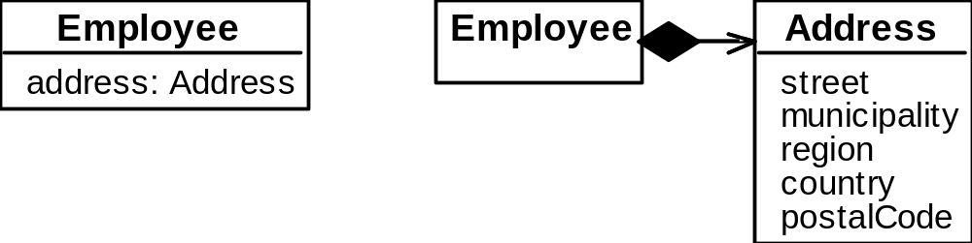
Composition
A composition is a strong kind of aggregation
  if the aggregate is destroyed, then the parts are destroyed as well
Two alternatives for addresses
*
*
*
*
Building
*
Room

Slide 45
Aggregation hierarchy
Vehicle
1
1
*
*
Chassis
BodyPanel
Door
1
1
1
1
*
Frame
Engine
Transmission
Wheel

Slide 46
Suggested sequence of activities
Identify a first set of candidate classes
Add associations and attributes
Find generalizations
List the main responsibilities of each class
Decide on specific operations
Iterate over the entire process until the model is satisfactory
  Add or delete classes, associations, attributes, generalizations, responsibilities or operations
Don’t be too disorganized. Don’t be too rigid either.

Slide 47
A simple technique for discovering domain classes
Look at a source material such as a description of requirements
Extract the nouns and noun phrases
Eliminate nouns that:
  are redundant
  represent instances
  are vague or highly general
  not needed in the application
Pay attention to classes in a domain model that represent types of users or other actors

Slide 48
Identifying associations and attributes
Start with classes you think are most central and important
Decide on the clear and obvious data it must contain and its relationships to other classes.
Work outwards towards the classes that are less important.
Avoid adding many associations and attributes to a class
  A system is simpler if it manipulates less information

Slide 49
Tips about identifying and specifying valid associations
An association should exist if a class
    possesses
    controls
    is connected to
    is related to
    is a part of
    has as parts
    is a member of, or
    has as members
some other class in your model
Specify the multiplicity at both ends
Label it clearly.

Slide 50
Actions versus associations
A common mistake is to represent actions as if they were associations
LibraryPatron
*
*
*
*
*
*
LibraryPatron
borrow
return
Loan
*
borrowedDate
*
*
dueDate
*
CollectionItem
CollectionItem
returnedDate
Better: The
borrow
operation creates a
Loan
, and
Bad, due to the use of associations
the
return
operation sets the
returnedDate
that are actions
attribute.

Slide 51
Identifying attributes
Look for information that must be maintained about each class
Several nouns rejected as classes, may now become attributes
An attribute should generally contain a simple value
  E.g. string, number

Slide 52
Tips about identifying and specifying valid attributes
It is not good to have many duplicate attributes
If a subset of a class’s attributes form a coherent group, then create a distinct class containing these attributes
Person
Person
Person
Address
*
*
*
*
addresses
name
name
name
*
street
addresses
street1
municipality
municipality1
provOrState
Bad due to
provOrState1
country
a plural
country1
postalcode
attribute
postalCode1
type
street2
municipality2
Good solution. The
provOrState2
type indicates whether
country2
it is a home address,
postalCode2
business address etc.
Bad due to too many
attributes, and inability
to add more addresses

Slide 53
An example (attributes and associations)
Employee
Passenger
RegularFlight
name
*
name
employeeNumber
time
number
jobFunction
supervisor
flightNumber
*
*
*
*
*
*
*
*
*
*
*
*
*
*
*
*
*
*
*
Booking
*
*
*
*
*
*
SpecificFlight
seatNumber
date

Slide 54
Identifying generalizations
There are two ways to identify generalizations:
  bottom-up
    Group together similar classes creating a new superclass
  top-down
    Look for more general classes first, specialize them if needed

Slide 55
An example (generalization)
0..2
Person
0..2
0..2
0..2
0..2
PersonRole
0..2
name
idNumber
RegularFlight
*
EmployeeRole
time
PassengerRole
jobFunction
supervisor
flightNumber
*
*
*
*
*
*
*
*
*
*
*
*
*
*
*
*
*
*
*
Booking
*
*
*
*
*
*
SpecificFlight
seatNumber
date

Slide 56
End of Chapter

